Slide 1

Is work experience an accurate predictor of job placement?
NJIT Data Science & Analytics
Milestone 3 Project 1/2023
Brittney Price

Slide 2

Agenda
Introduction
Research Question
Data
Modeling
Evaluation
Takeaways
Conclusion

Slide 3

Introduction
I am a career changer.
I chose a bootcamp program over getting another undergraduate degree.
I have done all the right things—gotten an internship, done well in classes, worked with my career coach, updated my resume, gotten some actual real-world experience under my belt and even done a few paid short-term projects for various companies
When it’s come to finding a full-time job in data science I have been hitting roadblocks.
Is it because I didn’t get my undergrad in data science, economics, statistics or finance?
Is it because I don’t have a master’s?
Is it because I’m a female?
Is it because I don’t have enough work experience?
I decided to do an analysis of a job placement dataset to find out what variables are most likely to impact placement.

Slide 4

The most important question to answer: is work experience an accurate predictor of job placement?
Let’s dive in

Slide 5

About this file This file contains different attributes of the candidates educational history and work experience. The detailed data dictionary is given below:
Data Dictionary
gender : Gender of the candidate ssc_percentage : Senior secondary exams percentage (10th Grade) ssc_board : Board of education for ssc exams hsc_percentage : Higher secondary exams percentage (12th Grade) hsc_borad : Board of education for hsc exams hsc_subject : Subject of study for hsc degree_percentage : Percentage of marks in undergrad degree undergrad_degree : Undergrad degree majors work_experience : Past work experience emp_test_percentage : Aptitude test percentage specialization : Postgrad degree majors - (MBA specialization) mba_percent : Percentage of marks in MBA degree status (TARGET) : Status of placement. Placed / Not Placed

Slide 6
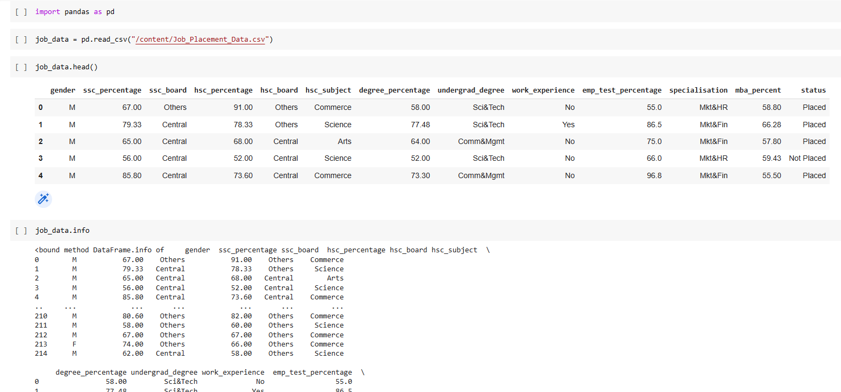
Taking a look at the data in Python

Slide 7
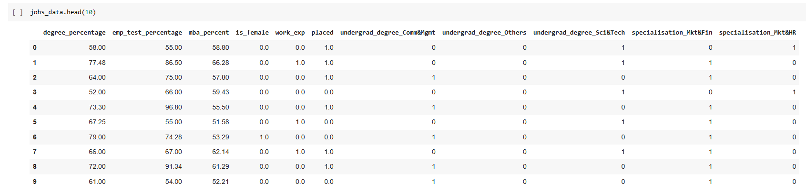
After cleaning/encoding the data and dropping unnecessary columns

Slide 8

I chose to focus on work experience, gender, grades in undergrad, grades in grad school, aptitude test scores, what their undergrad was in, and what their graduate degree was in.
I split the data into features of interest and a target variable (“placed”).

Slide 9
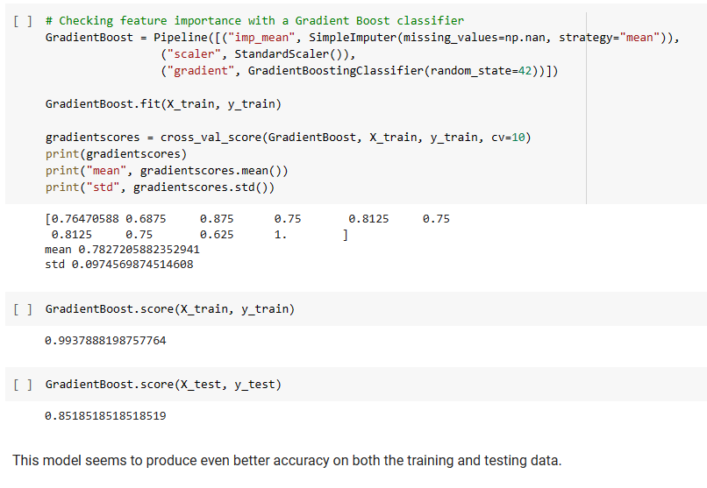


After trying a few models I finally have one I’m happy with– a Gradient Boost classifier
The model was stable with a training score of 0.994 and a testing score of 0.852

Slide 10
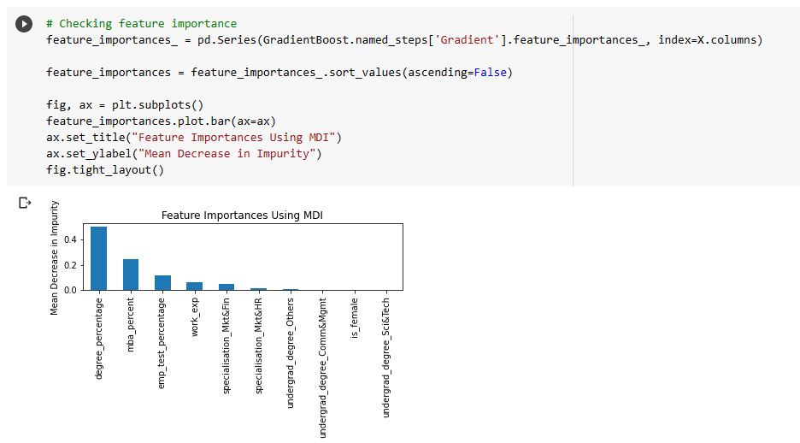
I also ran a check for feature importance
It appears that a candidates’ percentage of marks in their undergrad have the highest impact on job placement
(I thought it would have been work experience for sure!)

Slide 11
1. Undergrad grades seem to have the highest impact on job placement 2. Followed by exam scores during their graduate courses 3. Work experience didn’t have as much of an impact as expected, although it was still statistically significant 4. People who went into Marketing & Finance had better job placement than people who went into Marketing & HR
Takeaways:

Slide 12

Team
Brittney Price
NJIT Data Science & Analytics Student
Data Analyst

Slide 13
Conclusion
A lot of factors affect job placement.
Work experience doesn’t have as much of an impact as I thought.
Going into Finance seems to be a good path right now for those that aren’t sure what they want to do with their careers.
I’m happy to see that the evidence in this dataset is showing me that gender isn’t impacting job placement (yay progress!)
Do well in school. Take it seriously. Doing well in school seems to have the biggest impact on landing a job!

